Slide 1

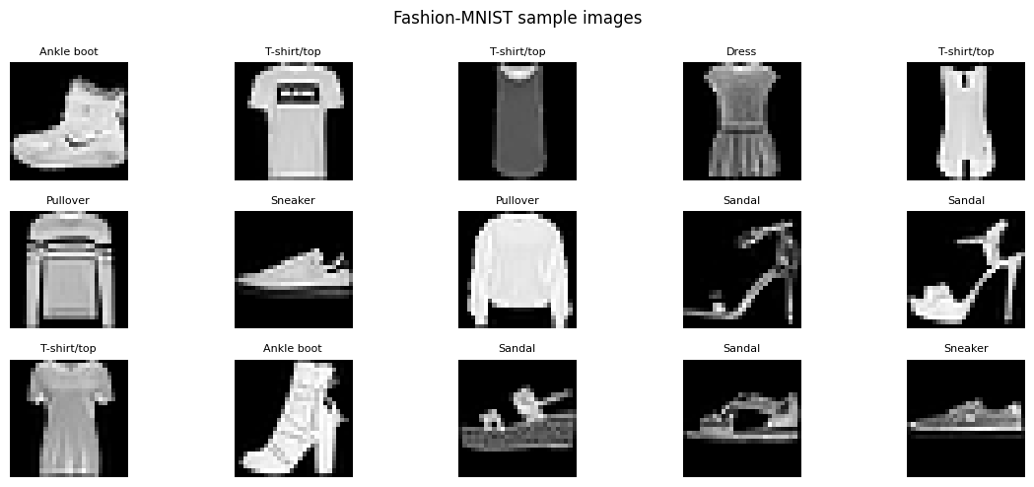
ASSIGNMENT–02 | GENERATIVE AI LAB | CO3 AND CO4
Comparative Study and Practical Analysis of Generative AI Models
Dataset: Fashion MNIST
Group Members:
Sakshi Walunj - 202502110007
Dhanashri Shah - 202502110008
Shreya Bhosale - 202502110010
Notes:
Speaker: Shreya (about 40 sec): Introduce the group and the objective. We compared four generative models: Autoencoder and VAE for image reconstruction (CO3), and DCGAN and a pretrained Stable Diffusion model for image generation (CO4). We ran them in Google Colab on Fashion-MNIST, and Stable Diffusion on a text prompt, and analysed the actual outputs.

Slide 2
Four models compared
 | Autoencoder | VAE | DCGAN | Stable Diffusion
Principle | Encoder compresses, decoder rebuilds the image | Encodes a latent distribution (mean, log-var); samples, then decodes | Generator vs discriminator trained adversarially | Iterative denoising of latents, guided by text
Components | Encoder, latent vector, decoder | Encoder, mean/log-var, sampling, decoder | Generator, discriminator | Text encoder, U-Net, scheduler, VAE
Advantages | Simple, fast, keeps detail | Structured latent space, can sample | Sharp, fast generation | Detailed, text-controllable
Limitations | Cannot generate well; loses fine detail | Blurrier outputs; KL trade-off | Unstable training, artefacts | Heavy compute; slow sampling
Applications | Denoising, compression, anomaly detection | Representation learning, interpolation | Synthetic data, image synthesis | Text-to-image, editing, design
Output seen | Sharper reconstruction | Smoother reconstruction | 28×28 gray, some artefacts | 512×512 realistic sneaker
Notes:
Speaker: Shreya (about 60 sec): Walk the table by column. AE is deterministic compression. VAE adds a probabilistic latent space with KL loss. DCGAN trains two networks against each other. Stable Diffusion removes noise step by step in latent space, guided by a text prompt. Point out the last row: the outputs we actually observed.

Slide 3
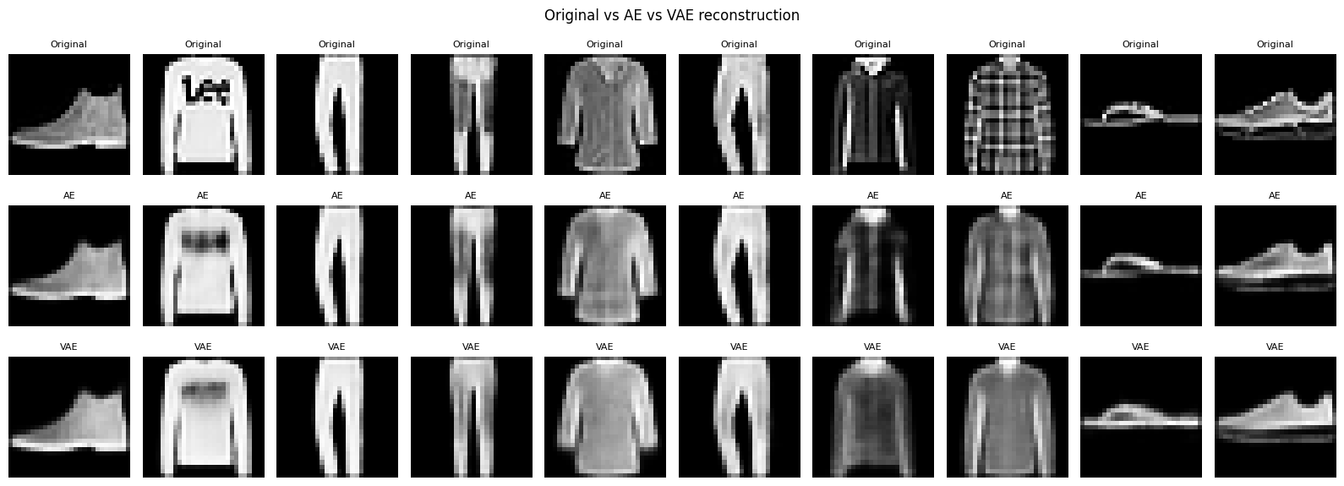
CO3: Autoencoder vs VAE reconstruction
Rows: original, AE, VAE (same 10 test images)
AE keeps more detail (plaid pattern, sandal straps); logo text is blurred in both
VAE is smoother and lower in contrast; MSE is about 44% higher
Caveat: VAE has a smaller latent (64 vs 128) and a KL penalty
Notes:
Speaker: Sakshi (about 60 sec): Both models reconstruct the same ten Fashion-MNIST test images. The Autoencoder has lower error, MSE 0.0064 against 0.0093, and keeps more texture. The VAE output is smoother and blurrier because its latent space is regularised by the KL term. Note the caveat: the VAE latent is smaller, so this is a trade-off, and pixel metrics do not fully describe perceptual quality.

Slide 4
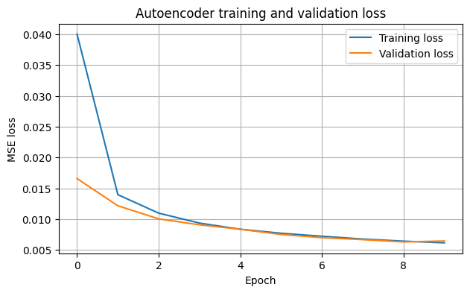
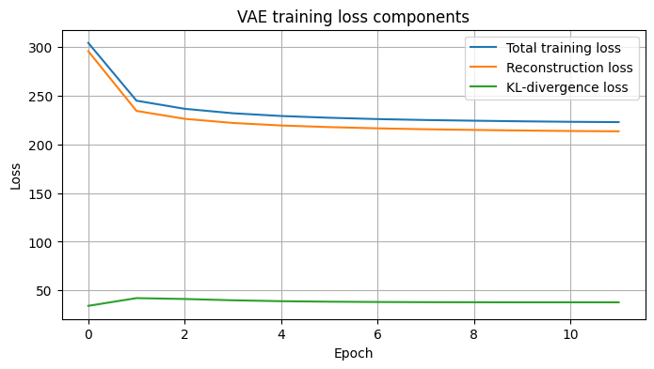
MSE and MAE loss

Slide 5
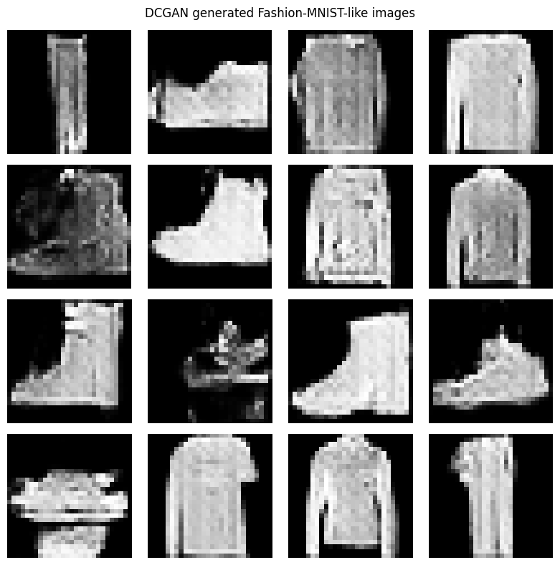
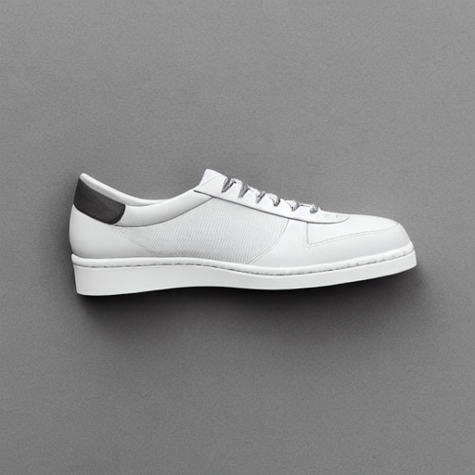
CO4: DCGAN vs Stable Diffusion generation
DCGAN: recognisable shapes, low resolution, some noisy samples.
Stable Diffusion: realistic and prompt-faithful, but heavy compute.
DCGAN: 28×28 gray, 15 epochs
Stable Diffusion: 512×512, 20 steps
Notes:
Speakers: Shreya (DCGAN) then Dhanashri (Stable Diffusion), about 60 sec: DCGAN generates new 28 by 28 grayscale clothing images from noise. Shirts, boots and trousers are recognisable, but some samples are noisy or distorted. Stable Diffusion, a pretrained latent diffusion model, produced a realistic 512 by 512 sneaker that follows the prompt, though laces and stitching are simplified and it needs far more compute. The comparison is qualitative because data, resolution and conditioning differ.

Slide 6
Group reflection and key takeaways
Sakshi Walunj - 202502110007
Studied AE and VAE architectures, analysed reconstruction outputs, compared MSE and MAE, and evaluated the results.
AI tools and verification
ChatGPT and Claude for code, explanations and drafting; Colab, Keras, PyTorch, Diffusers. Outputs checked against inputs, metrics, prompts and documentation.
SW
Shreya Bhosale - 202502110010
Fashion-MNIST preprocessing and DCGAN implementation; analysed generated images, training results; prepared report, PPT.
SB
Key learning
Reconstruction is not generation. AE is deterministic, VAE probabilistic, DCGAN adversarial, and diffusion denoises under text guidance.
Dhanashri Shah - 202502110008
Studied and implemented Stable Diffusion, analysed generated images and prompts, and documented the results.
DS
Notes:
All three members share this slide (about 60 sec). Cover AI tools used and the verification steps, then the key learning, then each member states their own contribution. Finish with the main message: the right model depends on the task, reconstruction fidelity versus generative quality, and on available compute. Then open for questions.

